Slide 1
Computer Graphics And Multimedia Applications SCSA1302
Unit 5

Slide 2
Syllabus
UNIT V MULTIMEDIA BASICS AND TOOLS
Introduction to multimedia - Compression & Decompression - Data & File Format standards - Digital voice and audio - Video image and animation. Introduction to Photoshop – Workplace – Tools – Navigating window – Importing and exporting images – Operations on Images – resize, crop, and rotate. Introduction to Flash – Elements of flash document – flash environment – Drawing tools – Flash animations – Importing and exporting - Adding sounds – Publishing flash movies – Basic action scripts – GoTo, Play, Stop, Tell Target.

Slide 3
INTRODUCTION TO MULTIMEDIA
Multimedia is a combination of text, graphic art, and sound, animation and video elements.
The IBM dictionary of computing describes multimedia as "comprehensive material, presented in a combination of text, graphics, video, animation and sound. Any system that is capable of presenting multimedia, is called a multimedia system".
A multimedia application accepts input from the user by means of a keyboard, voice or pointing device.
Multimedia applications involve using multimedia technology for business, education and entertainment. Multimedia is now available on standard computer platforms.

Slide 4
APPLICATIONS
Business - In any business enterprise, multimedia exists in the form of advertisements, presentations, video conferencing, voice mail, etc.
Schools - Multimedia tools for learning are widely used these days. People of all ages learn easily and quickly when they are presented information with the visual treat.
Home PCs equipped with CD-ROMs and game machines hooked up with TV screens have brought home entertainment to new levels. These multimedia titles viewed at home would probably be available on the multimedia highway soon.
Public places - Interactive maps at public places like libraries, museums, airports and the stand-alone terminal
Virtual Reality (VR) - This technology helps us feel a 'real life-like' experience. Games using virtual reality effect is very popular

Slide 5
Multimedia Elements :
Multimedia applications require dynamic handling of data consisting of a mix of text, voice, audio components, video components, and image animation.
Integrated multimedia applications allow the user to cut sections of all or any of these components and paste them in a new document or in another application such as an animated sequence of events, a. desktop publishing system, or a spreadsheet.
Facsimile:
Facsimile transmissions were the first practical means of transmitting document images over telephone lines.
to allow higher scanning density for better-quality fax
Document images :
Document images are used for storing business documents that must be retained for long periods of time
Providing multimedia access to such documents removes the need far making several copies of the original for storage or distribution

Slide 6
Photographic images :
Photographic images are used for a wide range of applications . such as employee records for instant identification at a security desk, real estates systems with photographs of houses in the database containing the description of houses, medical case histories, and so on.
Geographic information systems map (GIS):
Map created in a GIS system are being used wildly for natural resources and wild life management as well as urban planning.
Voice commands and voice synthesis:
used for hands-free operations of a computer program.
Audio message:
Annotated voice mail already uses audio or voice message as attachments to memos and documents such as maintenance manuals.

Slide 7
Video messages:
Video messages are being used in a manner similar to annotated voice mail.
Holographic images:
Holographic images extend the concept of virtual reality by allowing the user to get "inside" a part, such as, an engine and view its operation from the inside.
Fractals:
This technology is based on synthesizing and storing algorithms that describes the information.

Slide 8
COMPRESSION AND DECOMPRESSION
Compression is the way of making files to take up less space.
In multimedia systems, in order to manage large multimedia data objects efficiently, these data objects need to be compressed to reduce the file size for storage of these objects.
Compression tries to eliminate redundancies in the pattern of data.
Once such redundancies are removed, the data object requires less time for transmission over a network.
This in turn significantly reduces storage and transmission costs.

Slide 9
TYPES OF COMPRESSION
Lossy compression:
compression causes some information to be lost; some information at a delete level is considered not essential for a reasonable reproduction of the scene. This type of compression is called lossy compression.
Lossless Compression:
In lossless compression, data is not altered or lost in the process of compression or decompression.
Decompression generates an exact replica of the original object
Eg: Text Compression

Slide 10
Lossless compression techniques are good for text data and for repetitive data in images all like binary images and gray-scale images. Some of the commonly accepted lossless standards are given below:
• Packpits encoding (Run-length encoding)
• CCITT Group 3 I D
• CCITT Group 3 2D
• CCITT Group 4
• Lempe l-Ziv and Welch algorithm LZW.

Slide 11
Lossy compression is that some loss would occur while compressing information objects.
Lossy compression is used for compressing audio, gray-scale or color images, and video objects in which absolute data accuracy is not necessary.
The idea behind the lossy compression is that, the human eye fills in the missing information in the case of video.
But, an important consideration is how much information can be lost so that the result should not affect.
The following lists some of the lossy compression mechanisms:
Joint Photographic Experts Group (JPEG)
Moving Picture Experts Group (MPEG)
Intel DVI
CCITT H.261 (P * 24) Video Coding Algorithm
Fractals.

Slide 12
Binary Image compression schemes
A binary image containing black and white pixel is generated when a document is scanned in a binary mode.
The schemes are applicable in office/business documents, handwritten text, line graphics, engineering drawings, and so on.
A scanner scans a document as sequential scan lines, starting from the top of the page.
A scan line is complete line of pixels, of height equal to one pixel, running across the page.
Each scan line is scanned from left to right of the page generating black and white pixels for that scan line.

Slide 13
This uncompressed image consists of a single bit per pixel containing black and white pixels.
Binary 1 represents a black pixel, binary 0 a white pixel.
Several schemes have been standardized and used to achieve various levels of compressions.
1. Pack pits Encoding( Run-Length Encoding)
2. CCITT Group 3 1-D Compression

Slide 14
1. Pack pits Encoding( Run-Length Encoding)
It is a scheme in which a consecutive repeated string of characters is replaced by two bytes.
It is used to compress black and white (binary) images.
Among two bytes which are being replaced, the first byte contains a number representing the number of times the character is repeated, and the second byte contains the character itself.
2. CCITT Group 3 1-D Compression
This scheme is based on run-length encoding and assumes that a typical scan line has long runs of the same color.
This scheme was designed for black and white images only, not for gray scale or color images.

Slide 15
Huffman Encoding
A modified version of run-length encoding is Huffman encoding.
It is used for many software based document imaging systems.
It is used for encoding the pixel run length in CCITT Group 3 1-dGroup 4.
It is variable-length encoding
It generates the shortest code for frequently occurring run lengths and longer code for less frequently occurring run lengths.

Slide 16
Mathematical Algorithm for huffman encoding:
Huffman encoding scheme is based on a coding tree.
It is constructed based on the probability of occurrence of white pixels or black pixels in the run length or bit stream.

Slide 17
Huffman code
In computer science and information theory, a Huffman code is a particular type of optimal prefix code that is commonly used for lossless data compression.
The output from Huffman's algorithm can be viewed as a variable-length code table for encoding a source symbol (such as a character in a file).

Slide 18
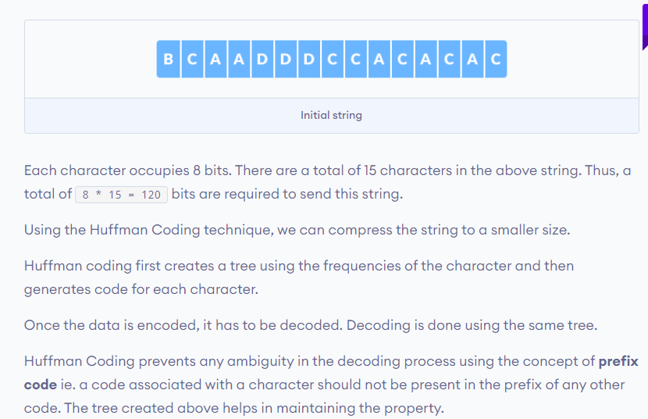
Huffman code

Slide 19
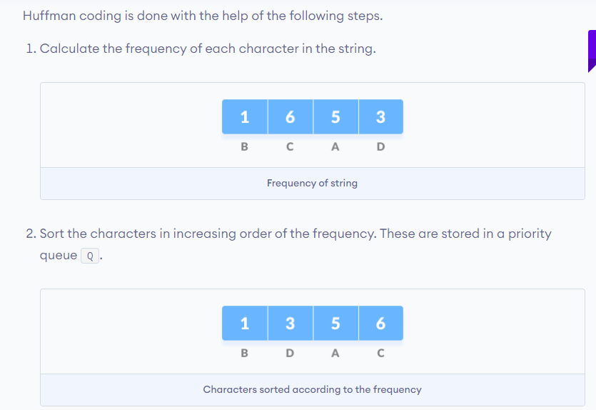
Huffman code

Slide 20
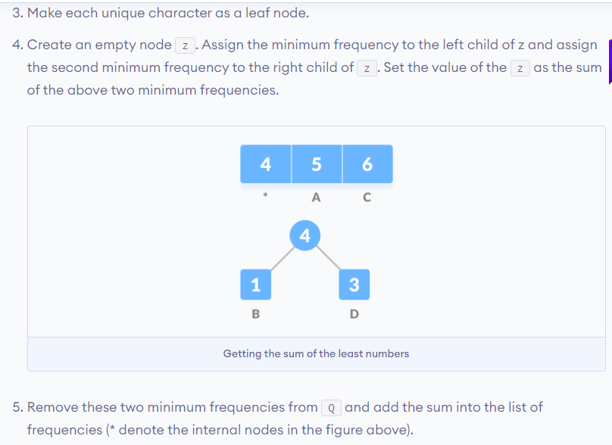
Huffman code

Slide 21
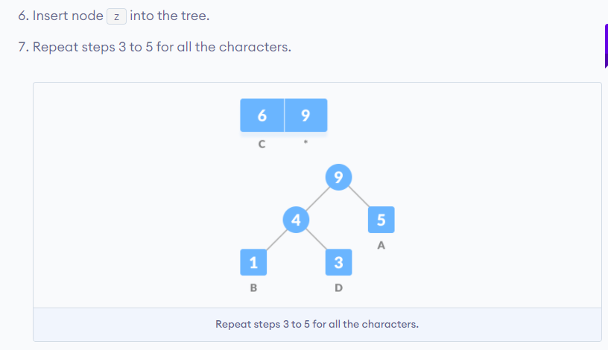
Huffman code

Slide 22
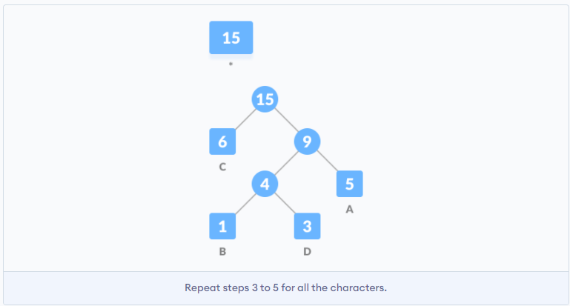
Huffman code

Slide 23
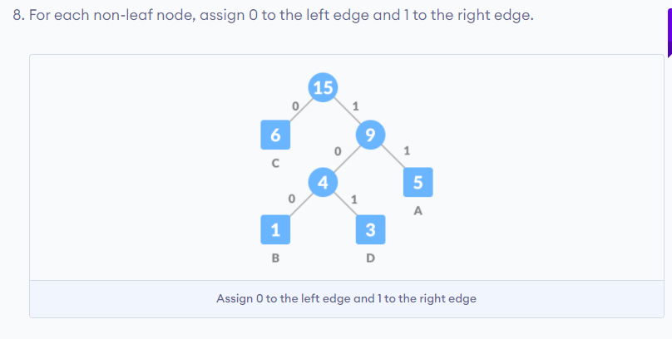
Huffman code

Slide 24
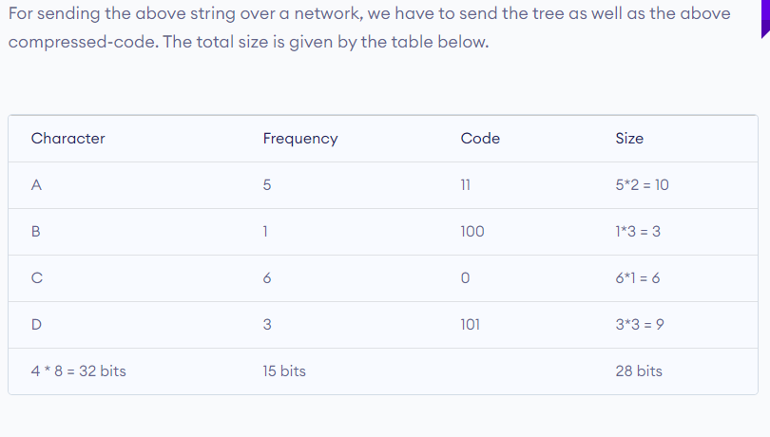
Huffman code

Slide 25
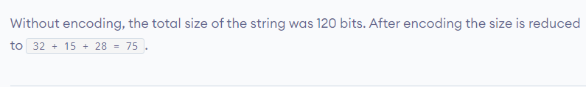
Huffman code

Slide 26
JOINT PHOTOGRAPHIC EXPERTS GROUP COMPRESSION (JPEG)
ISO and CCITT working committee joint together and formed Joint Photographic Experts Group.
It is focused exclusively on still image compression.
Another joint committee, known as the Motion Picture Experts Group (MPEG), is concerned with full motion video standards.
JPEG is a compression standard for still color images and grayscale images, otherwise known as continuous tone images.

Slide 27
JPEG has been released as an ISO standard in two parts
Part I specifies the modes of operation, the interchange formats, and the encoder/decoder specifies for these modes along with substantial implementation guide lines.
Part 2 describes compliance tests which determine whether the implementation of an encoder or decoder conforms to the standard specification of part I to ensure interoperability of systems compliant with JPEG standards

Slide 28
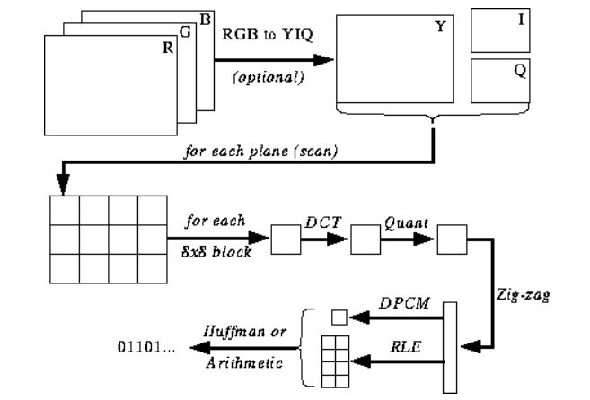
JPEG Encoding

Slide 29
JPEG Encoding
Decoding - Reverse the order for encoding
The Major Steps in JPEG Coding involve:
DCT (Discrete Cosine Transformation)
Quantization
Zigzag Scan
DPCM on DC component
RLE on AC Components
Entropy Coding

Slide 30
Discrete Cosine Transform(DCT)
Spatial domain ⟺ Frequency domain.
Outputs DCT coefficients (containing spatial frequencies), which relate directly to how much the pixel values change as function of their position in the block:
A lot of variations in pixel values: Represents an image with a lot of fine detail.
Small variations in pixel values: Uniform color change and little fine detail.
When there is little variations in pixel values, only a few data points are required to represent the image.
DCT does not provide any compression:
◦ Rearranges the data into a form that allows another coding technique to compress the data more effectively

Slide 31
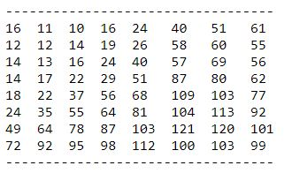
Quantization
Used to throw out bits
Example: 101101 = 45 (6 bits).
Truncate to 4 bits: 1011 = 11.
Truncate to 3 bits: 101 = 5.
Quantization error is the main source of the Lossy Compression.
Quantization Tables
In JPEG, each F[u,v] is divided by a constant q(u,v).
Table of q(u,v) is called quantization table.
Eye is most sensitive to low frequencies (upper left corner), less sensitive to high frequencies (lower right corner)

Slide 32
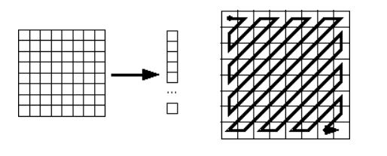
Zig-zag Scan
What is the purpose of the Zig-zag Scan:
to group low frequency coefficients in top of vector.
Maps 8 x 8 to a 1 x 64 vector

Slide 33
Differential Pulse Code Modulation (DPCM) on DC component
Here we see that besides DCT another encoding method is employed: DPCM on the DC component at least. Why is this strategy adopted:
DC component is large and varied, but often close to previous value (like lossless JPEG).
Encode the difference from previous 8x8 blocks – DPCM
Run Length Encode (RLE) on AC components
Yet another simple compression technique is applied to the AC component:
1x64 vector has lots of zeros in it
Encode as (skip, value) pairs, where skip is the number of zeros and value is the next non-zero component.
Send (0,0) as end-of-block sentinel value.

Slide 34
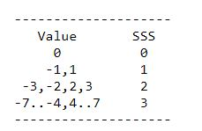
Entropy Coding
DC and AC components finally need to be represented by a smaller number of bits
Categorize DC values into SSS (number of bits needed to represent) and actual bits.
Example: if DC value is 4, 3 bits are needed.
Send off SSS as Huffman symbol, followed by actual 3 bits.
For AC components (skip, value), encode the composite symbol (skip,SSS) using the Huffman coding.
Huffman Tables can be custom (sent in header) or default.

Slide 35
Summary of the JPEG bit stream
JPEG components have described how compression is achieved at several stages. Let us conclude by summarizing the overall compression process:
A "Frame" is a picture, a "scan" is a pass through the pixels (e.g., the red component), a "segment" is a group of blocks, a "block" is an 8x8 group of pixels.
Frame header: sample precision (width, height) of image number of components unique ID (for each component) horizontal/vertical sampling factors (for each component) quantization table to use (for each component)
Scan header Number of components in scan component ID (for each component) Huffman table for each component (for each component)
Misc. (can occur between headers) Quantization tables Huffman Tables Arithmetic Coding Tables Comments Application Data

Slide 36
Moving Picture Experts Group Compression
MPEG stands for "Moving Picture Experts Group.“
MPEG is an organization that develops standards for encoding digital audio and video.
It works with the International Organization for Standardization (ISO) and the International Electro technical Commission (IEC) to ensure media compression standards are widely adopted and universally available.
The MPEG organization has produced a number of digital media standards since its inception in 1998. Examples include:

Slide 37
MPEG-1 – Audio/video standards designed for digital storage media (such as an MP3 file)
MPEG-2 – Standards for digital television and DVD video
MPEG-4 – Multimedia standards for the computers, mobile devices, and the web
MPEG-7 – Standards for the description and search of multimedia content
MPEG-MAR – A mixed reality and augmented reality reference model
MPEG-DASH – Standards that provide solutions for streaming multimedia data over HTTP (such as servers and CDNs)

Slide 38
Using MPEG compression, the file size of a multimedia file can be significantly reduced with little noticeable loss in quality.
This makes transferring files over the internet more efficient, which helps conserve Internet bandwidth.
MPEG compression is so ubiquitous that the term "MPEG" is commonly used to refer to a video file saved in an MPEG file format rather than the organization itself.
These files usually have a ".mpg" or ".mpeg" file extension.
File extensions: .MP3, .MP4, .M4V, .MPG, .MPE, .MPEG

Slide 39
MPEG compression removes two types of redundancies:
Spatial redundancy:
the value of a pixel is predictable given the values of neighboring pixels.
It is removed with the help of DCT compression.
2. Temporal redundancy:
Pixels in two video frames that have the same values in the same location .
It is removed with the help of Motion compensation technique.

Slide 40
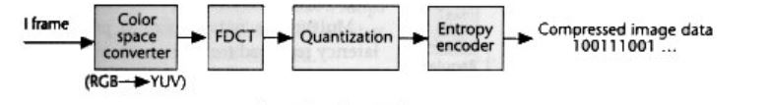
MPEG constructs three types of pictures namely:
Intra pictures (I-pictures)
Predicted pictures (P-pictures)
Bidirectional predicted pictures (B-pictures)
The MPEG algorithm employs following steps:
Intra frame DCT coding (I-pictures):
The I-pictures are compressed as if they are JPEG images.

Slide 41
Motion-compensated inter-frame prediction (P-pictures):
In most video sequences there is a little change in the contents of image from one frame to the next.
Most video compression schemes take advantage of this redundancy by using the previous frame to generate a prediction of current frame.
This is based on current value to predict next value and code their difference called as prediction error.
The frame to be compared is split in to blocks first and then best matching block is searched.
Each block uses previous picture for estimating prediction.
This search process is called as prediction.

Slide 42
B-frame (Bidirectional predictive frame):
-Frames can also be predicted from future frames.
Such frames are usually predicted from two directions, i.e. from the I- or P-frames that immediately precede or follow the predicted frame.
-These bidirectionally predicted frames are called B-frames.
A coding scheme could, for instance, be IBBPBBPBBPBB.
-B-pictures uses the previous or next I-frame or P-frame for motion compensation and offers the highest degree of compression.
Each block in a B-picture can be forward, backward or bidirectionally predicted.

Slide 43
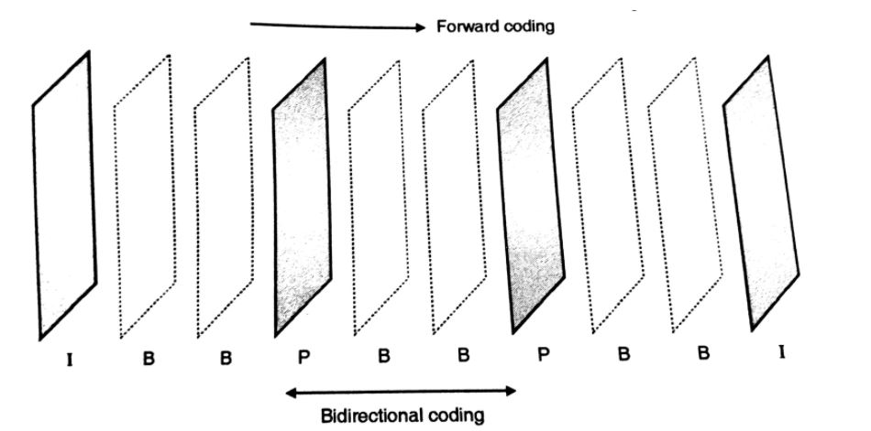

Slide 44
Bidirectional predicted pictures (B):
Bidirectional predicted pictures utilize three types of motion compression techniques.
Forward motion compensation - uses past picture information.
Backward motion compensation - uses future picture information .
Bidirectional compensation - uses the average of the past and future picture information.

Slide 45
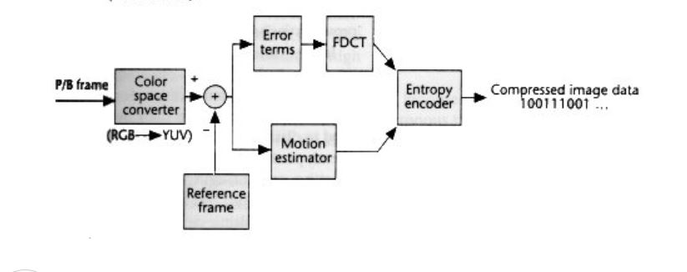

Slide 46
DATA AND FILE FORMATS STANDARDS
There are large number of formats and standards available for multimedia system. Let us discuss about the following file formats:
• Rich-Text Format (RTF)
• Tagged Image file Format (TIFF)
• Resource Image File Format (RIFF)
• Musical Instrument Digital Interface (MIDI)
• Joint Photographic Experts Group (JPEG)
• Audio Video Interleaved (AVI) file format
• TWAIN.

Slide 47
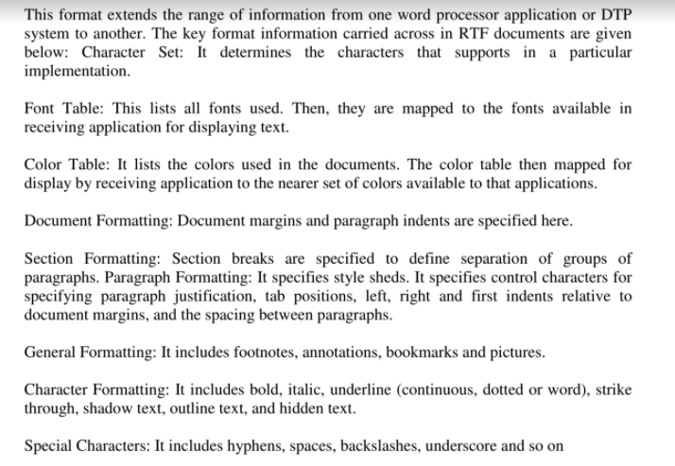
Rich Text Format

Slide 48
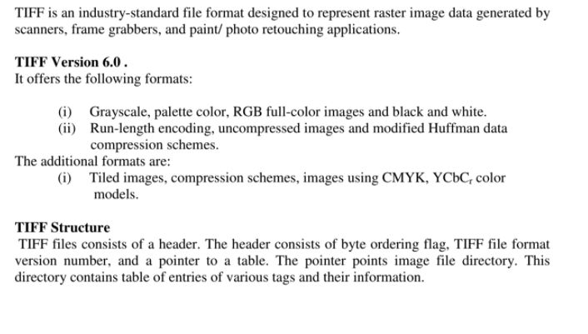
TIFF File Format

Slide 49
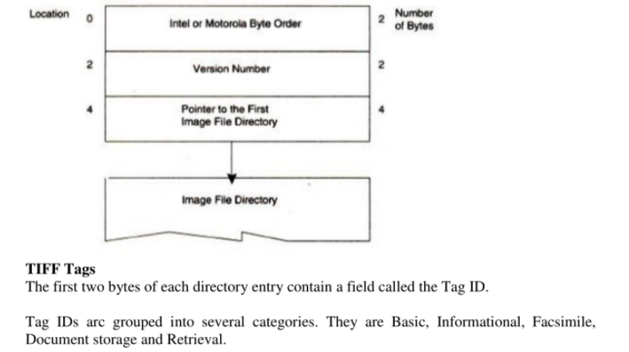
TIFF file format Header:

Slide 50
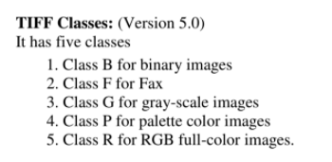
TIFF Classes

Slide 51
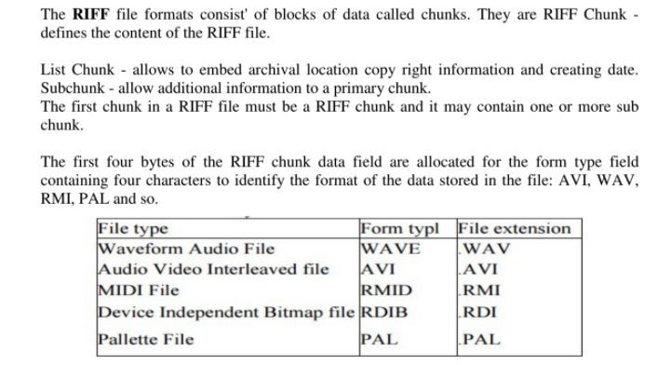
Resource Inter change File Format (RIFF)

Slide 52
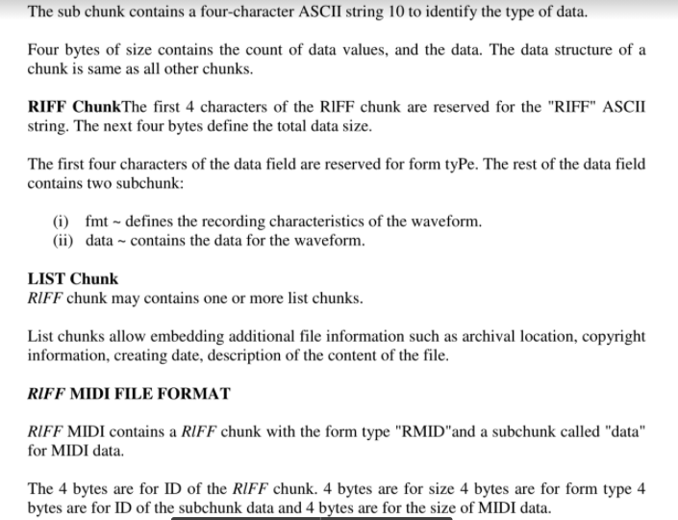

Slide 53
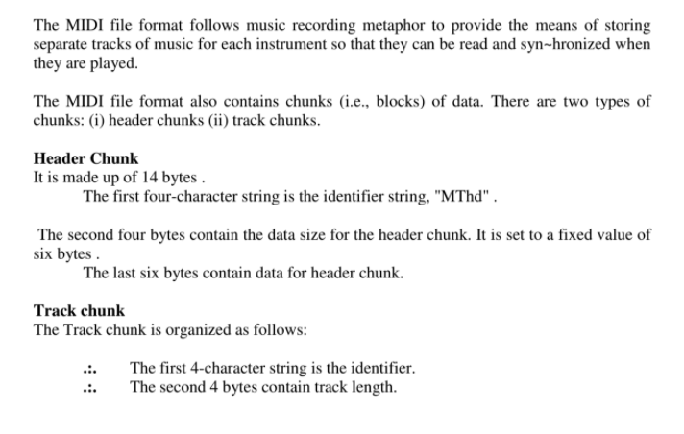
MIDI File Format

Slide 54
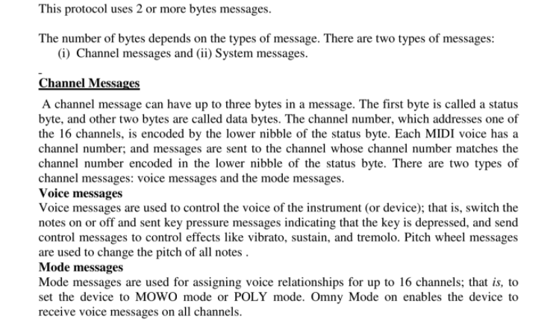
MIDI Communication Protocol

Slide 55
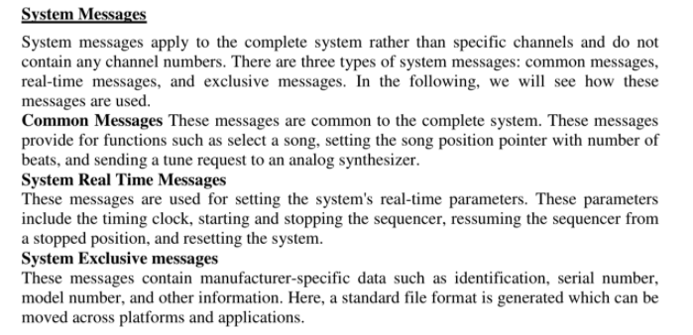

Slide 56
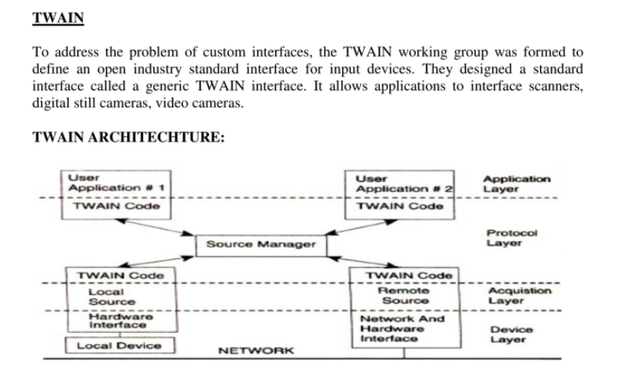
TWAIN

Slide 57
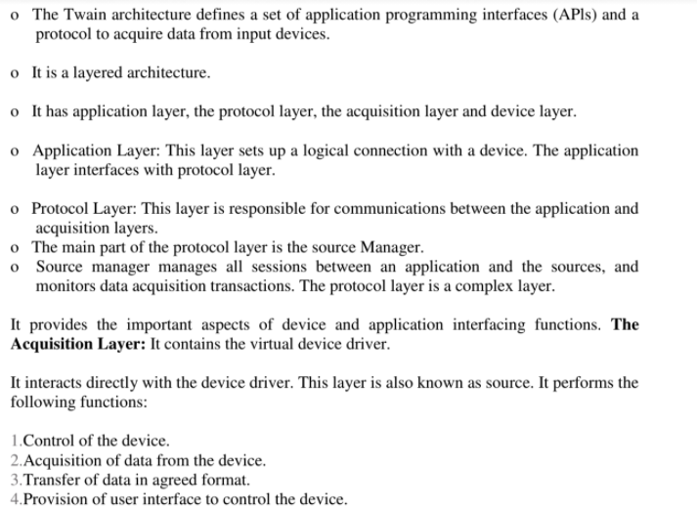
TWAIN

Slide 58
TWAIN
The Device Layer: The device layer receives software commands and controls the device hardware. NEW WAVE RIFF File Format: This format contains two sub chunks:
(i) Fmt (ii) Data.

Slide 59
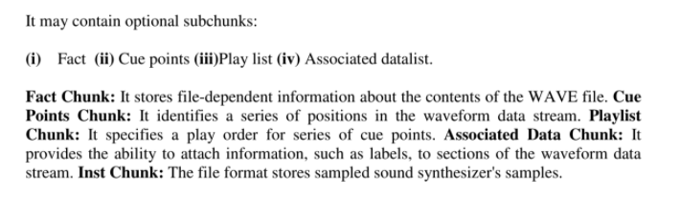
TWAIN

Slide 60
DIGITAL VOICE AND AUDIO Digital Audio
Sound is made up of continuous analog sine waves that tend to repeat depending on the music or voice.
The analog waveforms are converted into digital format by analog-to-digital converter (ADC) using sampling process.
Sampling process :Sampling is a process where the analog signal is sampled over time at regular intervals to obtain the amplitude of the analog signal at the sampling time.
Sampling rate: The regular interval at which the sampling occurs is called the sampling rate.

Slide 61
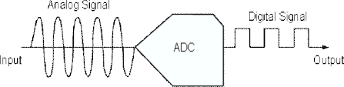

Slide 62
Digital Voice
Speech is analog in nature and is converted to digital form by an analog-to-digital converter (ADC).
An ADC takes an input signal from a microphone and converts the amplitude of the sampled analog signal to an 8, 16 or 32 bit digital value.
The four important factors governing the ADC process are sampling rate, resolution, linearity and conversion speed.
• Sampling Rate: The rate at which the ADC takes a sample of an analog signal.
• Resolution: The number of bits utilized for conversion determines the resolution of ADC.
• Linearity: Linearity implies that the sampling is linear at all frequencies and that the amplitude tmly represents the signal.
• Conversion Speed: It is a speed of ADC to convert the analog signal into Digital signals. It must be fast enough.

Slide 63
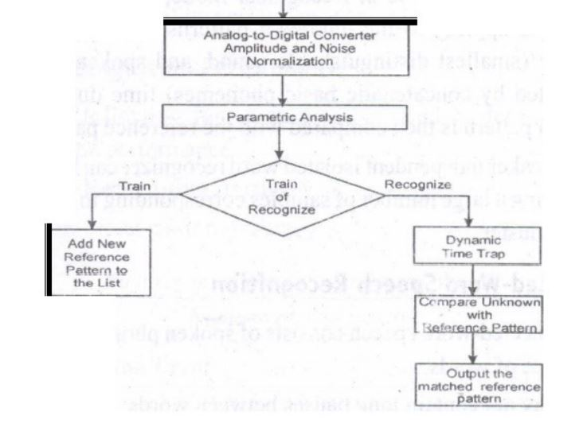
VOICE RECOGNITION SYSTEM

Slide 64
VOICE Recognition System
Voice Recognition Systems can be classified into three types.
1.Isolated-word Speech Recognition.
2.Connected-word Speech Recognition.
3.Continuous Speech Recognition.

Slide 65
Isolated-word Speech Recognition
It provides recognition of a single word at a time.
The user must separate every word by a pause.
The pause marks the end of one word and the beginning of the next word.
Stage 1: Normalization The recognizer's first task is to carry out amplitude and noise normalization to minimize the variation in speech due to ambient noise, the speaker's voice, the speaker's distance from and position relative to the microphone, and the speaker's breath noise.
Stage2: Parametric Analysis It is a preprocessing stage that extracts relevent time-varying sequences of speech parameters.
This stage serves two purposes: (i) It extracts time-varying speech parameters. (ii) It reduces the amount of data of extracting the relevant speech parameters.
Training mode: In training mode of the recognizer, the new frames are added to the reference list.
Recognizer mode: If the recognizer is in Recognizer mode, then dynamic time warping is applied to the unknown patterns to average out the phoneme (smallest distinguishable sound, and spoken words are constructed by concatenatic basic phonemes) time duration.
The unknown pattern is then compared with the reference patterns. A speaker independent isolated word recognizer can be achieved by grouping a large number of samples corresponding to a word into a single cluster.

Slide 66
Connected-Word Speech Recognition
Connected-word speech consists of spoken phrase consisting of a sequence of words. It may not contain long pauses between words.
The method using Word Spotting technique
It recognizes words in a connected-word phrase.
In this technique, Recognition is carried out by compensating for rate of speech variations by the process called dynamic time warping (this process is used to expand or compress the time duration of the word), and sliding the adjusted connected-word phrase representation in time past a stored word template for a likely match.

Slide 67
Continuous Speech Recognition
This system can be divided into three sections:
(i) A section consisting of digitization, amplitude normalization, time normalization and parametric representation.
(ii) Second section consisting of segmentation and labeling of the speech segment into a symbolic string based on a knowledge based or rule-based systems.
(iii) The final section is to match speech segments to recognize word sequences

Slide 68
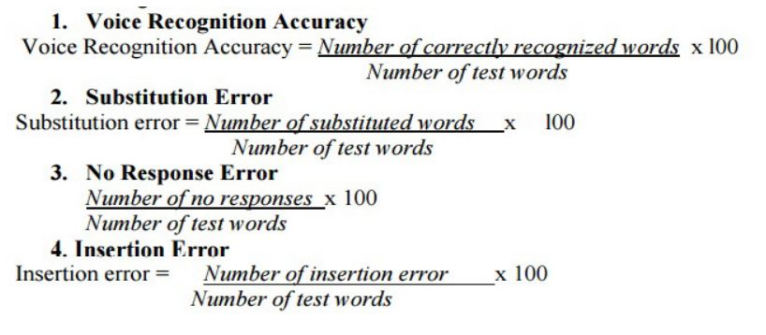
Voice Recognition performance
It is categorized into two measures: Voice recognition performance and system performance. The following four measures are used to determine voice recognition performance.

Slide 69
Voice Recognition Applications
Voice mail integration: The voice-mail message can be integrated with e-mail messages to create an integrated message.
DataBase Input and Query Applications
• Application such as order entry and tracking It is a server function; It is centralized; Remote users can dial into the system to enter an order or to track the order by making a Voice query.
• Voice-activated rolodex or address book When a user speaks the name of the person, the rolodex application searches the name and address and voice-synthesizes the name, address, telephone numbers and fax numbers of a selected person.
In medical emergency, ambulance technicians can dial in and register patients by speaking into the hospital's centralized system.
Police can make a voice query through central data base to take follow-up action ifhe catch any suspect.
Language-teaching systems are an obvious use for this technology. The system can ask the student to spell or speak a word.
Foreign language learning

Slide 70
Musical Instrument Digital Interface (MIDI)
MIDI interface is developed by Daver Smith of sequential circuits, inc in 1982. It is an universal synthesizer interface .
MIDI Specification 1.0
MIDI is a system specification consisting of both hardware and software components which define inter-connectivity and a communication protocol for electronic synthesizers, sequences, rythm machines, personal computers, and other electronic musical instruments.

Slide 71
MIDI Hardware Specification
The MIDI hardware specification require five pin panel mount requires five pin panel mount receptacle DIN connectors for MIDI IN, MIDI OUT and MIDI THRU signals.
MIDI IN connector is for input signals The MIDI OUT is for output signals MIDI THRU connector is for daisy-chaining multiple MIDI instruments.
MIDI Interconnections
The MIDI IN port of an instrument receives MIDI messages to play the instrument's internal synthesizer.
The MIDI OUT port sends MIDI messages to play these messages to an external synthesizer.
The MIDI OUT port sends MIDI messages to play these messages to an external synthesizer

Slide 72
Communication Protocol
The MIDI communication protocol uses multibyte messages; There are two types of messages:
(i) Channel messages
(ii) System messages
The channel messages have three bytes. The first byte is called a status byte, and the other two bytes are called data bytes.
The two types of channel messages: (i) Voice messages (ii) Mode messages.
System messages: The three types of system messages.
Common message: These messages are common to the complete system. These messages provide for functions.
System real time messages: These messages are used for setting the system's real-time parameters. These parameters include the timing clock, starting and stopping the sequencer, resuming the sequencer from a stopped position and restarting the system.
System exclusive message: These messages contain manufacturer specific data such as identification, serial number, model number and other information.

Slide 73
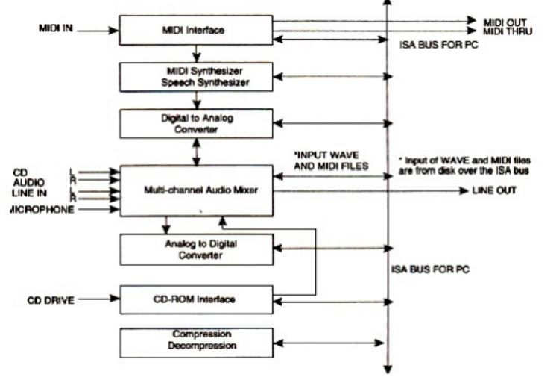
SOUND BOARD ARCHITECTURE

Slide 74
SOUND BOARD ARCHITECTURE
A sound card consist of the following components:
MIDI Input/Output Circuitry,
MIDI Synthesizer Chip,
input mixture circuitry to mix CD audio input with LINE IN input and microphone input,
analog-to-digital converter with a pulse code modulation circuit to convert analog signals to digital to create WAVfiles,
a decompression and compression chip to compress and decompress audio files,
a speech synthesizer to synthesize speech output,
a speech recognition circuitry to recognize speech input and output circuitry to output stereo audio OUT or LINEOUT.

Slide 75
AUDIO MIXER
The audio mixer component of the sound card typically has external inputs for stereo CD audio, stereo LINE IN, and stereo microphone MICIN.
These are analog inputs, and they go through analog-to-digital conversion in conjunction with PCM or ADPCM to generate digitized samples.
Analog-to-Digital Converters: The ADC gets its input from the audio mixer and converts the amplitude of a sampled analog signal to either an 8-bit or 16-bit digital value.
Digital-to-Analog Converter (DAC): A DAC converts digital input in the 'foml of W AVE files, MIDI output and CD audio to analog output signals.
Sound Compression and Decompression: Most sound boards include a codec for sound compression and decompression. ADPCM for windows provides algorithms for sound compression.
CD-ROM Interface: The CD-ROM interface allows connecting u CD ROM drive to the sound board.

